Slide 1
Music Generator
Data Science Final Project Presentation
0751231 曾揚
309505018 郭俊廷

Slide 2



Introduction
一個音調 (note)或
一小段和弦 (chord)
Music Generator
一段鋼琴旋律 Melody (30秒)

Slide 3
Related Work
Music Generator
-> Embedding
-> bidirectional GRU
-> self-attention
-> dropout
-> bidirectional GRU
-> self-attention
-> dropout
-> bidirectional GRU
-> dropout
-> dense
-> Leaky ReLU
-> dense-> output
-> pretty_midi 轉成MIDI
-> 一段鋼琴旋律 Melody (30秒)
一小段和弦 (chord) MIDI file
-> pretty_midi 讀檔
-> 找出所有的音調(note)
-> note2vec 做 note Embedding
-> chord2vec 做 chord Embedding
-> 50維vector

Slide 4

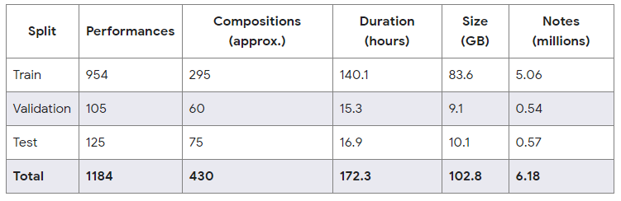
Approach - Datasets
The MAESTRO Dataset
https://magenta.tensorflow.org/datasets/maestro
maestro-v1.0.0-midi.zip

Slide 5
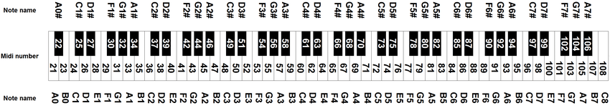
Approach - Data Preprocessing
CM7 和弦: C E G B
C7#9和弦: C E G Bb D#
C11和弦: C E G Bb D F
C13和弦: C E G Bb D F A

Slide 6
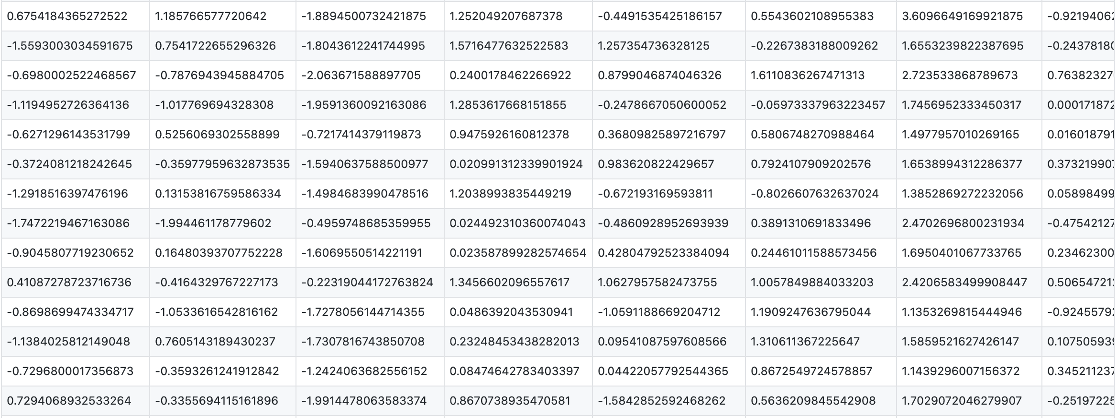
Approach - Note2vec
43
45
46
48
...
...
…
...
93
94
95
96
G2
G#2
A2
A#2
…
…
…
...
A6
A#6
B6
C7
https://github.com/philhchen/note2vec

Slide 7
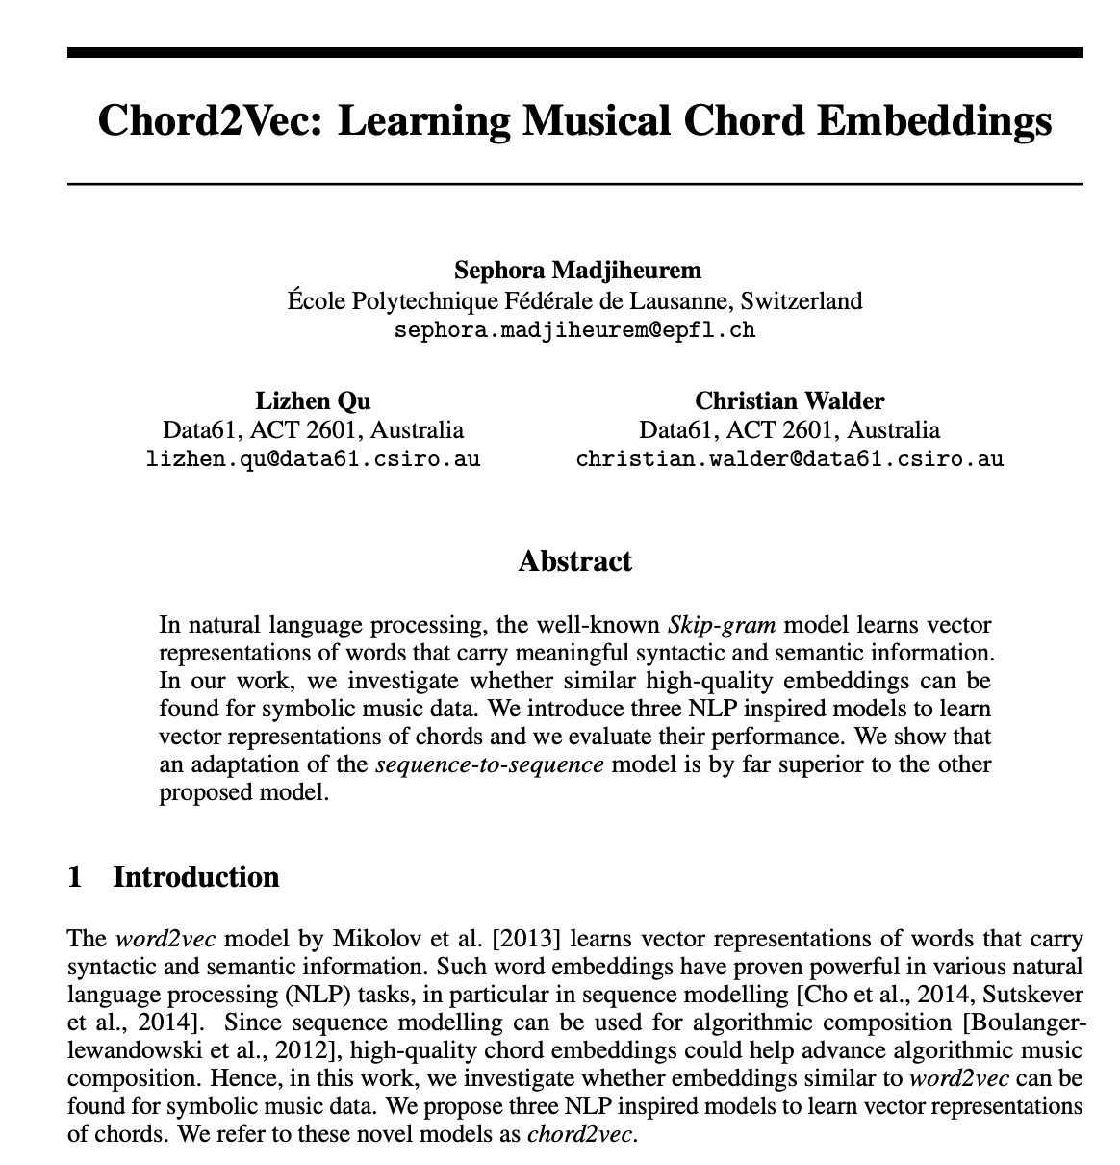
Approach - Chord2vec
CM7 和弦: C E G B
C7#9和弦: C E G Bb D#
C11和弦: C E G Bb D F
C13和弦: C E G Bb D F A
Chord2Vec: Learning Musical Chord Embeddings, NIPS 2016

Slide 8
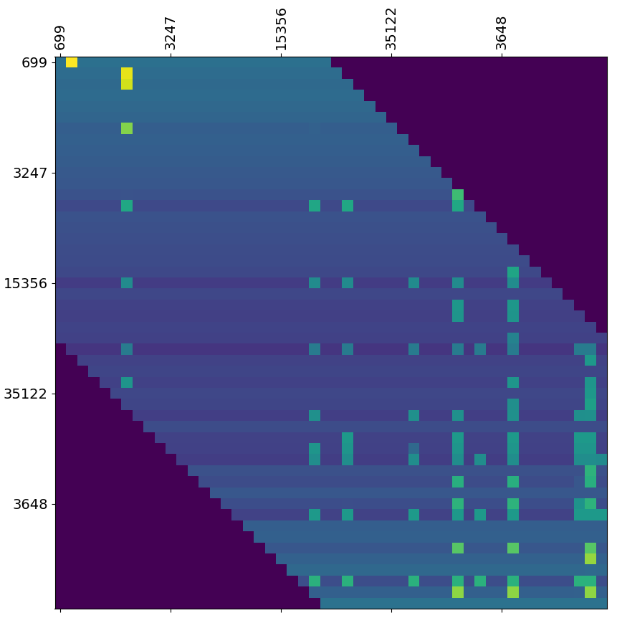
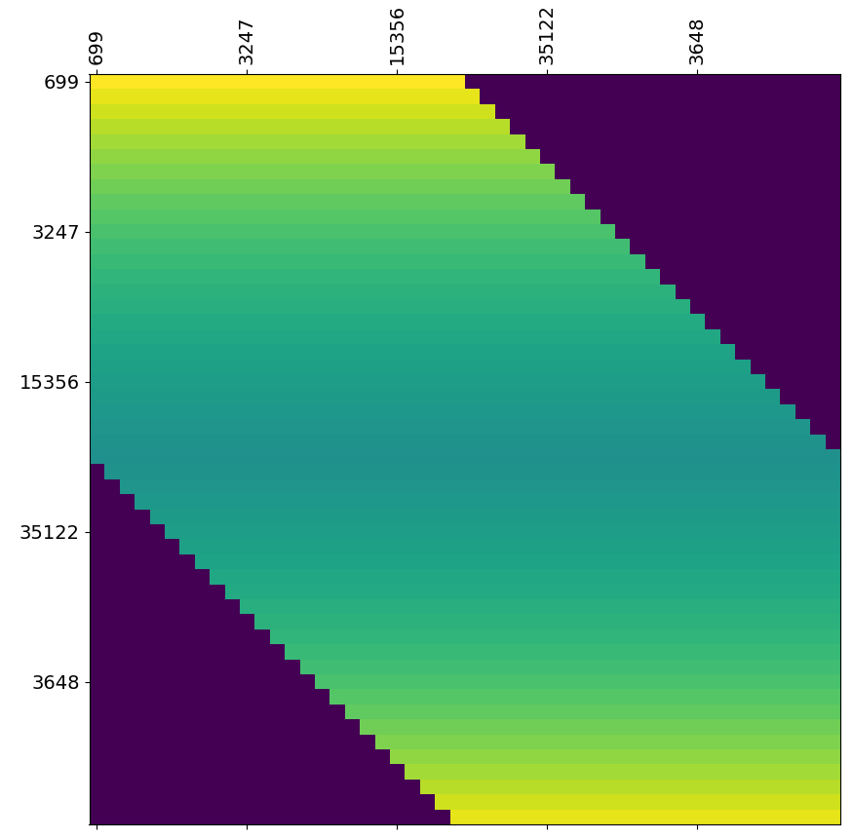
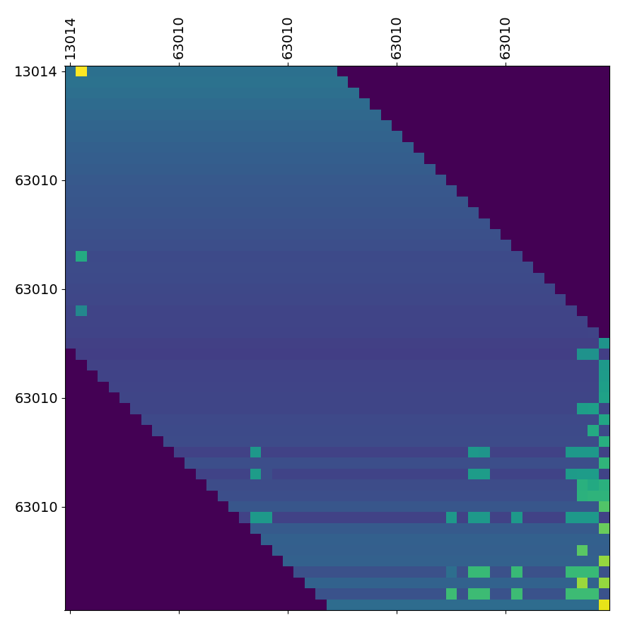
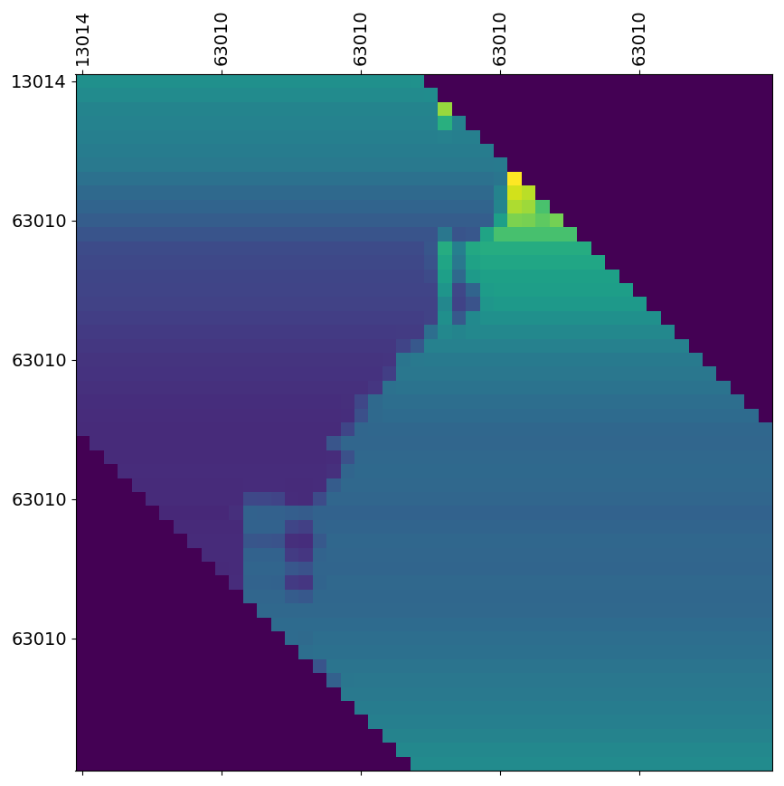
Approach - model Architecture
A3, Self-Attention Visualize
bidirectional GRU
1. 更好地理解上下文
Input
-> Embedding
-> bidirectional GRU
-> self-attention
-> dropout
-> bidirectional GRU
-> self-attention
-> dropout
-> bidirectional GRU
-> dropout
-> dense
-> Leaky ReLU
-> dense
-> output
self-attention
1. 更注重於 chord跟chord之間
2. 就算旋律比較長，也能從中間抓住重點，不丟失重要的資訊
3. 可以平行運算 增加效率
B3, Self-Attention Visualize

Slide 9

Conclusion
我們實作chord2vec作embedding, 並使用self-attention layer加強chord與chord之間的attention, 再加上雙向GRU作training, 最後也發現這個作法可以得到不錯的結果
Demo
G3
A3
B3

Slide 10
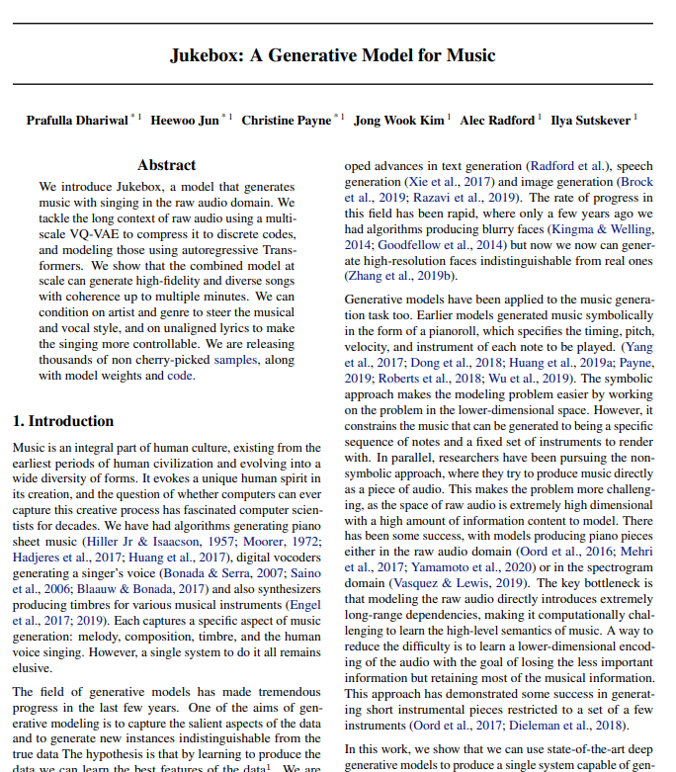
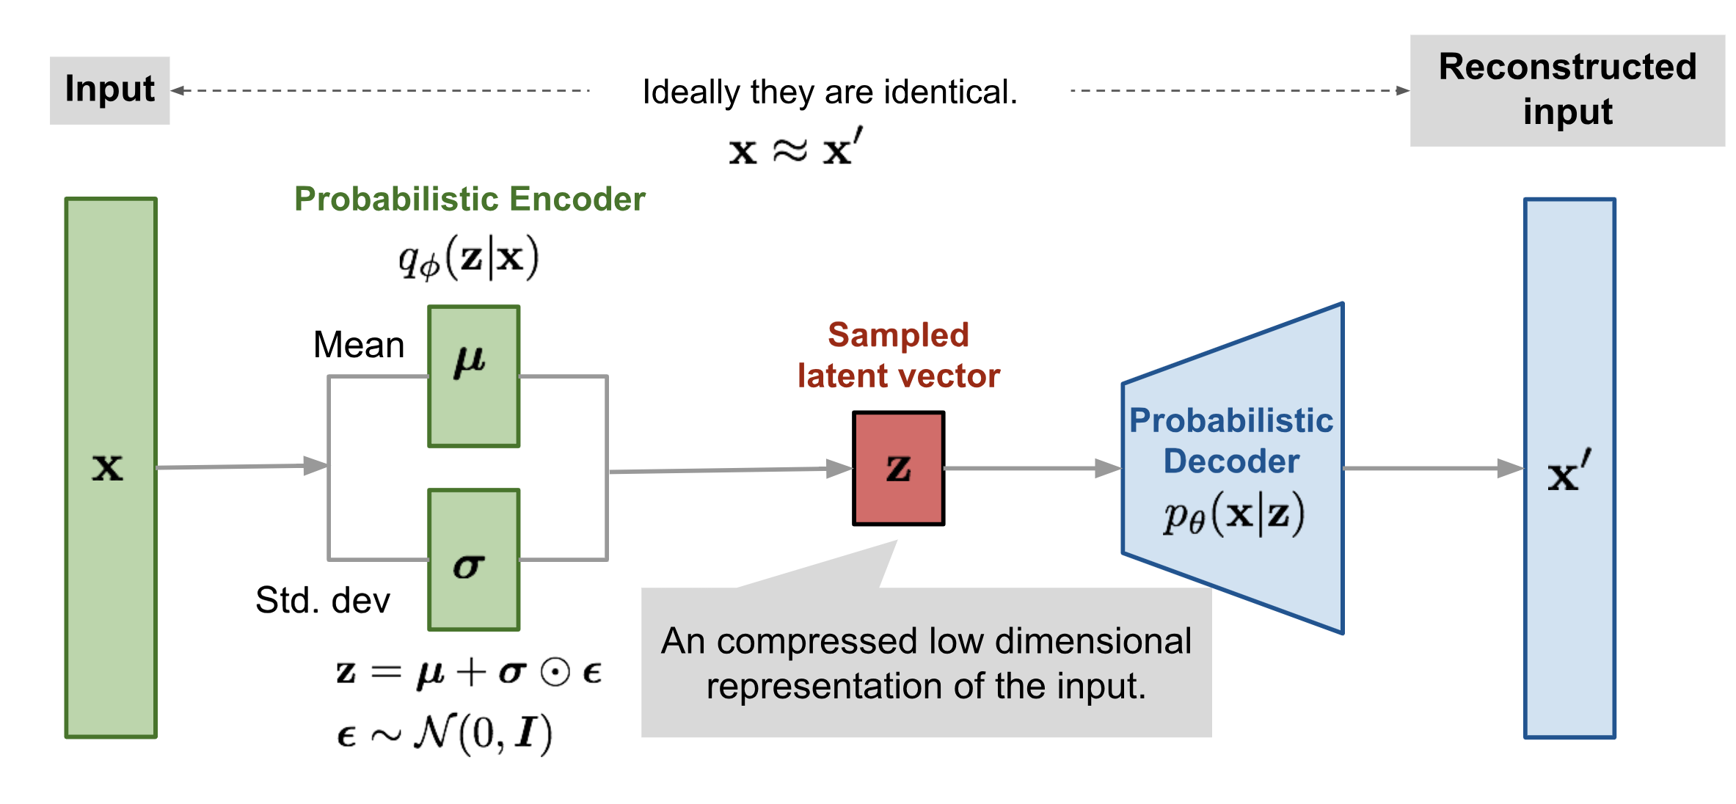
Future
OpenAI Jukebox
Jukebox: A generative model for music,
International Conference on Machine Learning(ICML), 2020
VAE (Variational AutoEncoder)

Slide 11
Thankyou
Q&A

